Slide 1
C
Chartership competencies Part 12| Breakfast Webinar Series
Katie Woollard

Slide 2
Introduction and Format
Introduce competency
Set out Key Questions
Give some example responses
Set some activities for today
Set some activities for this week

Slide 3
E Competencies
E1. Demonstrate continuing professional development
E2. Discuss your commitment to CIWEM
Notes:
You will need to identify your commitment to CIWEM, identifying your reasons for joining the Institution, how you have, will continue to or will in future contribute to developing the Institution (e.g. Branch meetings, journal papers, WEM articles, Special Interest Groups, Technical Panels, networks etc....).
• Why did you choose CIWEM?
• What have or will you contribute to CIWEM?
• How do you promote the benefits of CIWEM with your colleagues and other potential members?

Slide 4
E1
Demonstrating continuing professional development

Slide 5
E1
Demonstrating continuing professional development
You will need to demonstrate that you are recording your continued learning and professional development.
You will need to give examples of self-directed research (e.g. journals, magazines, legislative documents.......), training courses (e.g. H&S, presentation / report writing skills, new technology / software......), conferences, and technical panel meetings, seminars, publishing papers and giving presentations.
You will be aware of the need of Corporate members, to maintain at least 30 hours of CPD per year and keeping a record of this in the CIWEM template, illustrating how the learning is contributing to your ability to perform as a professional.

Slide 6
E1 – Key Questions
Do you have a personal development plan?
How do you plan what CPD to undertake?
Does your company have systems (e.g. annual reviews, CPD logs, development plans, individual training budgets etc) which help you identify CPD requirements and fulfil them?
Do you record examples of continued learning and personal development?
What have you learnt/gained from your CPD?
Do you explain and track the benefit of the CPD against your own personal development?
Are you maintaining at least 30 hours of CPD a year?
Do you coach, counsel or mentor others?

Slide 7
E1 - Recording CPD

Slide 8
E1 – Examples of CPD
Self directed research
Journals, magazines, legislative documents......
Training courses
H&S, presentation / report writing skills, new technology / software.....
Conferences
Technical panel meetings
Seminars
Publishing papers
Giving presentations
Coaching, counselling or mentoring others

Slide 9
E1 – Example
I have maintained a record of CPD from a range of sources throughout my career (attached).
I have year on year increased the amount of time spent on CPD as I have gained experience I have increased CPD in all areas and in particular to understand the economic, political and social context of my work.
I have continued to develop my professional experience and knowledge from my early career, attending training courses and workshops, to more recently delivering training and hosting workshops to develop the professional development of others and independent reading.
I maintain a technical specialism in SUBJECT and continue to advance my knowledge, understanding and competence in this area to a high level by regularly attending conference and advanced workshops to further my development in this area.
I plan my CPD via an individual development plan to maintaining my technical specialism, keep up-to-date with technological advances and underpin the wider context of the work I do.
At [LIST COMPANY] I undergo professional reviews and set development objectives to be achieved each year. This review also highlights any training needs which I address through training e.g. I have attended [LIST EXAMPLES OF TRAINING COURSES ATTENDED]
I am an [LIST TYPE OF MEMBERSHIP] member of the [LIST OTHER PROFESSIONAL BODY MEMBERSHIPS YOU MAY HAVE]. I attend training courses and conferences and read journals (e.g. GIVE SOME EXAMPLES).
I also subscribe to online bulletins [GIVE SOME EXAMPLES] to ensure that I keep abreast of current affairs.

Slide 10
Activity – Today
Discuss with your peers:
• Ideas for forms of CPD you have undertaken
• What was the last CPD event you went on?
• What did you learn / gain from it? How did it address a gap in your development plan?
• What was the most interesting or innovative CPD you have undertaken?
Ideas on the best way to keep an ongoing record of the CPD you have undertaken

Slide 11
Activity – this week
Update your CPD log
List types of CPD you have undertaken
Spend 15 minutes answering the key questions for this week
If you don’t have an individual development plan – discuss with your line manager

Slide 12
E Competencies
E1. Demonstrate continuing professional development
E2. Discuss your commitment to CIWEM
Notes:
You will need to identify your commitment to CIWEM, identifying your reasons for joining the Institution, how you have, will continue to or will in future contribute to developing the Institution (e.g. Branch meetings, journal papers, WEM articles, Special Interest Groups, Technical Panels, networks etc....).
• Why did you choose CIWEM?
• What have or will you contribute to CIWEM?
• How do you promote the benefits of CIWEM with your colleagues and other potential members?

Slide 13
E2
Discuss your commitment to CIWEM

Slide 14
E2
Discuss your commitment to CIWEM
You will need to identify your commitment to CIWEM, identifying your reasons for joining the Institution, how you have, will continue to or will in future contribute to developing the Institution (e.g. Branch meetings, journal papers, WEM articles, Special Interest Groups, Technical Panels, networks etc....).
• Why did you choose CIWEM?
• What have or will you contribute to CIWEM?
• How do you promote the benefits of CIWEM with your colleagues and other potential members?

Slide 15
Tips
Always write in the first person – CIWEM are only interested in what you have done, not what your team has done.
Be honest about what you have contributed to a project
Understand why you are doing a particular tasks – what is the bigger picture?
Be concise
Remember what you have written
Don’t limit your self to experience at current employer or paid employment

Slide 16
Other aspects of your application
A copy of your CV
Copies of relevant certificates (an Honours degree (or equivalent) is a requirement)
Your 1000 word Career Overview Report
Your training and CPD record for the last three years (showing a minimum of 30 hours CPD a year)
Your 4000 word Mandatory Competence Attainment Report which provides details of how your experience to date (there is a requirement for 5 years minimum experience) meets each of the 14 competencies (two examples per competency)
Have two sponsors who are members of CIWEM who can review your application. You will need to submit a signed letter from each of your sponsors alongside your application confirming they have done this.

Slide 17
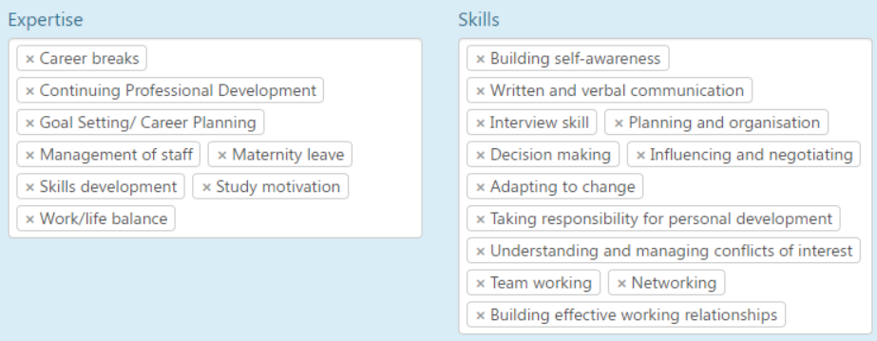
Sponsors and Mentors
CIWEM Mentor Platform now open – all free to use
https://www.ciwem.org/membership/mentoring
Not just for C.WEM – please do promote to your network.

Slide 18
Chartership Application Deadlines
10 August 2020: Application deadline
15 September 2020: Professional Standards Board Meeting
15 October 2020: Professional Review Interview (dates subject to change)
16 October 2020: Professional Review Interview (dates subject to change)
5 October 2020: Application deadline
10 November 2020: Professional Standards Board Meeting
10 December 2020: Professional Review Interview
11 December 2020: Professional Review Interview
1 December 2020: Final application deadline 2020

Slide 19
Well Done,
Thank you,
Good Luck!!
Chartership competencies | Breakfast Webinar Series
Please fill in the survey to help improve future series..

